Slide 1
Overview of 8086 Microprocessor
8086 Microprocessor is an enhanced version of 8085 Microprocessor that was designed by Intel in 1976. It is a 16-bit Microprocessor having 20 address lines and 16 data lines that provides up to 1MB storage. It consists of powerful instruction set, which provides operations like multiplication and division easily.
The most prominent features of a 8086 microprocessor are as follows −
It has an instruction queue, which is capable of storing six instruction bytes from the memory resulting in faster processing.
It was the first 16-bit processor having 16-bit ALU, 16-bit registers, internal data bus, and 16-bit external data bus resulting in faster processing.
It uses two stages of pipelining, i.e. Fetch Stage and Execute Stage, which improves performance.
Fetch stage can prefetch up to 6 bytes of instructions and stores them in the queue.
Execute stage executes these instructions.
It has 256 vectored interrupts.
It consists of 29,000 transistors.

Slide 2
Difference between 8085 and 8086 Microprocessor
Size − 8085 is 8-bit microprocessor, whereas 8086 is 16-bit microprocessor.
Address Bus − 8085 has 16-bit address bus while 8086 has 20-bit address bus.
Memory − 8085 can access up to 64Kb, whereas 8086 can access up to 1 Mb of memory.
Instruction − 8085 doesn’t have an instruction queue, whereas 8086 has an instruction queue.
Pipelining − 8085 doesn’t support a pipelined architecture while 8086 supports a pipelined architecture.
I/O − 8085 can address 2⁸ = 256 I/O's, whereas 8086 can access 2¹⁶ = 65,536 I/O's.
Cost − The cost of 8085 is low whereas that of 8086 is high.
Why do we need 8086 microprocessor?
The 8086 is a more advanced, efficient and fast operating microprocessor then 8085.

Slide 3

Internal Block Diagram of the 8086
Internal block diagram has been partitioned into two logical units;
(1) the Bus Interface Unit (BIU) (2) the Execution Unit (EU)
ES/DS
CS
SS
ADDRESS BUS
AH(8) | AL(8)
BH | BL
CH | CL
DH | DL
SP (16 bit)
BP(16 bit)
SI(16 bit)
DI(16 bit)
AX
BX
Data registers
20 bits
CX
DX
segment registers
ES
CS
SS
DS
IP
Address registers
808
6
BUS
BUS
CONTROL
UNIT
16 bits
TEMPORARY REGISTERS
EU
CONTROL
UNIT
INSTRUCTION QUEUE
ALU
1 | 2 | 3 | 4 | 5 | 6
8 bits
FLAGS
EXECUTION UNIT (EU)
BUS INTERFACE UNIT (BIU)

Slide 4
The Execution Unit (EU)
EU contains the arithmetic and logic unit (ALU), the control unit, an internal bus, plus a few registers
Register sets:
AX
ACCUMULATOR
AH | AL
BH | BL
CH | CL
DH | DL
BX
BASE REGISTER
CX
COUNT REGISTER
DX
DATA REGISTER
SP
BP
SI
DI
STACK POINTER
BASE POINTER
SOURCE INDEX
DESTINATION INDEX
IP
FLAGH | FLAGL
INSTRUCTION POINTER
STATUS FLAG
CS
DS
SS
ES
CODE SEGMENT REGISTER
DATA SEGMENT REGISTER
STACK SEGMENT REGISTER
EXTRA SEGMENT REGISTER

Slide 5
The Execution Unit
It contains the arithmetic and logic unit (ALU), the control unit, an internal bus, plus a few registers
Register sets:
8086 has four 16-bit general-purpose registers labeled as AX, BX, CX and DX. Each of these registers can also be used as two separate and exclusive 8-bit registers also i.e., AX has two parts AH and AL, where H and L stands for the high and low portions respectively.
AX: AL /AX is sometimes called the accumulator, but the relevance of the accumulator is less for 8086 compared to the earlier 8085 in which one operand is implied to be in the A register for many instructions.
BX, CX and DX:
These are the other working registers of the 8086, which means that temporary data storage, arithmetic calculations and data manipulation can be done with these registers
Base register BX is frequently used as an address register in many based addressing modes.
Counting register CX is used as a counter in many instructions.
Data register DX is used in I/O instructions as a pointer to data by storing the address of the I/O port.
Pointer and Index Registers : SP, BP, SI and DI are address registers, and can be used only as
16-bit registers
BP and SP : They are the Base pointer and Stack pointer respectively. SP always points to the top of the stack, while BP can point to any location in the stack.
SI and DI These are Index registers, labeled as Source Index and Destination Index respectively.
They function as address registers in various addressing modes

Slide 6



The Execution Unit contd..
Flag Register
It is a 16-bit register, of which 7 bits are unused. 6 bits are used as conditional flags. The others are control flags. The conditional flags available are the Carry (CF), Zero (ZF), Parity (PF), Overflow (OF) and the Sign Flag (SF).
D15 | D14 | D13 | D12 | D11 | D10 | D9 | D8 | D7 | D6 | D5 | D4 | D3 | D2 | D1 | D0
× | × | × | × | OF | DF | IF | TF | SF | ZF | × | AF | × | PF | × | CF
OF=1 if
i) there is an overflow into the MSB (8th or 16th bit) from the bit of lower significance, but no carry out from the MSB,
ii) there is a carry out from the MSB, but no carry into the MSB.
PF=1 if there is even number of 1s in lower 8-bits
SF=1 if the result contains a negative number
AF =1 if there is carry from bit D3 into D4.
CF=1 if there is a carry out from the MSB
ZF=1 if arithmetic or logic operation is zero,

Slide 7
Flag register:
Control flag
D15 | D14 | D13 | D12 | D11 | D10 | D9 | D8 | D7 | D6 | D5 | D4 | D3 | D2 | D1 | D0
× | × | × | × | OF | DF | IF | TF | SF | ZF | × | AF | × | PF | × | CF
This flag is specifically used in string instructions. If DF=1, then access the string data from higher memory location towards lower memory location. If DF=0, then access the string data from lower memory location towards higher memory location.
Interrupt Flag (I) – This flag is for interrupts.
If IF=1, the microprocessor will recognize interrupt requests from the peripherals.
If IF=0, the microprocessor will not recognize any interrupt requests and will ignore them.
Trap Flag (T) –If TF=1, the CPU automatically generates an internal interrupt after each instruction, allowing a program to be inspected as it executes instruction by instruction.
If TF=0, no function is performed.

Slide 8
The Execution Unit contd..
Solved Example on carry Flag
Q. Find the status of the flags CF, SF, AF after the following instructions are executed.
MOV AL, 35H
ADD AL, 0CEH
35H 0011 0101
+ CEH 1100 1110
103H 1 0000 0011
CF = 1 since there is a carry out from D7.
SF = 0 since the sign bit (MSB) of the 8-bit destination is 0.
AF = 1 since there is an overflow from D3 to D4.
Control Flags There are three control flags ; the Trap flag, Direction flag &Interrupt flag. The control flags have to be deliberately set or reset according to the requirements of the program. The Trap flag (TF) is set to perform step by step execution, during debugging. The Interrupt flag (IF) is set to enable interrupts. The Direction flag (DF) is used in string operations.
Arithmetic Logic Unit It is the part of a computer that performs all arithmetic and logic
computations. The ALU is the most important unit of the processor. Instructions that are
fetched and decoded, are executed in the ALU. Thus the ALU has direct access to the general purpose registers and flags.

Slide 9
Bus Interface Unit (BIU)
This unit BIU is responsible for address calculations, pre-fetching instructions for the queue and sequencing instructions one by one.
The Instruction Queue
Instructions are found in memory, from where they are fetched and decoded as and when they need to be executed.
However in 8086, there is a queue which fetches instructions ahead of the execution time and places them in a 6-byte first-in-first-out (FIFO) queue. This pre-fetching is done when the buses are free i.e., not being used for the execution of the current instruction.
The advantage of pre-fetching is that when a particular instruction is to be executed, there is a good chance of finding it in the queue (which is on-chip), rather than having to go to memory to fetch it.
This pre-fetching belongs to a class of ideas called pipelining, which means that both execution and fetching take place at the same time i.e., while the execution of one instruction is going on, the fetching of another one can be done.
Pipelining greatly speeds up processing.

Slide 10
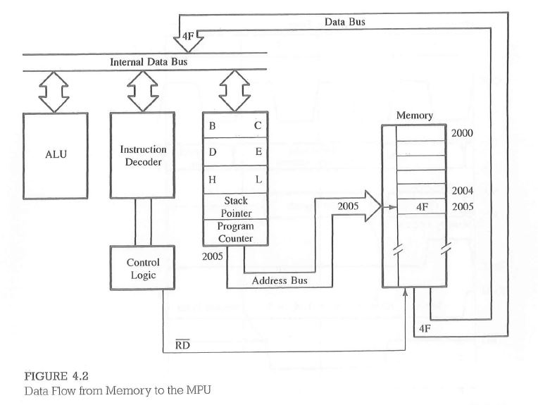
Concept of Pipelining
8086
2000 | 06 | MVI BL, 78H
2001 | 78
2002 | 3E | MVI AL,F2H
2003 | F2
2004 | 80 | ADD BL
2005 | 76 | HLT
AL=AL+BL
8085
Pre-fetching of next opcode is done
Opcode fetch
Decode
Execute
Decode and execution of first instruction code 06 78 in ALU
3E | F2 | 80 | 76 | ---- | ----
6-byte Instruction queue
EU
BIU
Processor

Slide 11
Memory Segmentation
The stack is used to keep aside address and data temporarily, when a subprogram is called
Base address
SS
Extra segment use to store data in a special way
A0000H
ES
Segment Register
90000H
SS
These registers are all 16-bit in size. Each register stores the base address of the corresponding Segment.
A000H
9000H
7000H
5000H
ES
DS
DS
70000H
CS
Total 2¹⁶=65,536=64K address locations & each location can store 1 byte data
CS
50000H
Data segment use to store data
The code segment contains code only
50000H= 0101 0000 0000 0000 0000 ➔20 bit address

Slide 12
Segments, Segment Registers & Offset Registers
Segment Size = 64KB
Maximum number of segments possible = 16
Logical Address – 16 bits
Physical Address – 20 bits
2 Logical Addresses for each Segments.
Base Address (16 bits)
Offset Address (16 bits)
Segment registers are used to store the Base address of the segment.

Slide 13
Memory Address Generation
The BIU has a dedicated adder for determining physical memory addresses.
Offset Value (16 bits)
Segment Register (16 bits)
0 0 0 0
Adder
Physical Address (20 Bits)

Slide 14
Segment : Offset Address
Logical Address is specified as segment:offset
Physical address is obtained by shifting the segment address 4 bits to the left and adding the offset address.
Thus the physical address of the logical address A4FB:4872 is:
A4FB0
+ 4872
A9822

Slide 15
Calculation of a physical address from the logical address for a data segment
Let a data byte is stored in a data segment, whose base address is 22220H.
Then the data segment register (DS) will contain the number 2222H.
The data at any location within this segment is referenced by an offset (displacement) with respect to the base address.
Thus, if a data at a location has a logical address specified as 2222H : 0016H, the number 0016H is the off set or displacement with respect to the base address.
Example for physical address calculation see figure given below
22236H
Address byte
- - - -
BYTE-2
BYTE-1
BYTE-0
Physical address
=22220H +
0016H
22236H
Data Segment
OFFSET=0016H (displacement)
Base address 22220H
2222H
DS Register

Slide 16
Memory Segmentation contd…
The Code Segment and the Instruction Pointer
The code segment is the area of memory where code alone is stored.
The offsets within the code segment are referenced using the Instruction Pointer (IP), which is a 16-bit register.
The IP sequences the instructions, and always points to the next instruction to be executed.
Whenever an instruction byte has to be fetched from memory, the bus interface unit (BIU) performs the address calculation using the contents of CS register and the IP.
This 20-bit address is then placed on the address bus and the instruction byte is fetched. Thus the logical address for an instruction bye is of the form CS : IP.
Example
The contents of the following segment registers are as given.
CS = 1111H
IP = 1232H.
Calculate the corresponding physical addresses for the addressed byte in a) CS
Address byte
- - - -
BYTE-2
BYTE-1
BYTE-0
Base address 11110H
Ans: The base address of the code segment is 11110H. The address of the next instruction to be
executed is referenced by CS and IP which is given by 11110H + 1232H = 12342H.
1111H
CS Register

Slide 17
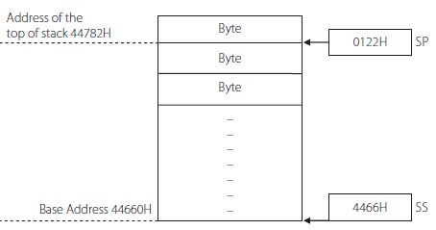
Memory Segmentation contd…
The Stack Segment and the Stack Pointer
The stack is an area of memory that is used in a special way.
There is a 16-bit register called Stack Pointer (SP) which points to the top of the stack.
The upper 16 bits of its base address is available in the SS register.
A stack address of the form 4466H : 0122H means that the SS register contains 4466H, the stack pointer (SP) contains the number 0122H, and the physical address of the top of the stack is 44660H + 0122H = 44782H
The 8086 has a stack which grows downwards (i.e., to lower memory addresses).
Thus the format SS : BP is also a logical address.

Slide 18
Memory Segmentation contd…
The Data Segment and Extra Segment
Both these segments store data, but in certain special cases (string instructions), it may be necessary to list them separately.
There is an Extra Segment (ES) register to store the upper 16 bits of the base address of the extra segment.
The offset within the data segment is also termed as an ‘effective address’.
The effective address calculation depends on the mode of addressing.
Table Segments and Corresponding Registers Used for Specifying Offsets
Segment | Offset Registers | Function
CS | IP | Address of the next instruction
DS | BX, DI, SI | Address of data
SS | SP, BP | Addresses in the stack
ES | BX, DI, SI | Address of destination data (for string instructions)

Slide 19
Memory Segmentation contd…
Advantages of Segmentation
It allows all address registers to have the same size as the data registers (16-bit), while allowing the use of 20-bit physical addresses.
All addresses in memory are re-locatable. This means that any program or data can be loaded in any address in memory. A re-locatable program is one which can be placed in any area of memory and executed without change. Data is also re-locatable. Changing the base address of the corresponding segment is the only action we need to perform, in order to re-locate. All addresses within the program are relative to the base address, as they are of the form Base address: off set. All processors in the x86 family have this kind of segmentation.

Slide 20
Addressing Modes
For computations in assembly language, we need an opcode and operands
The way in which operands are specified in an assembly language instruction is called its addressing mode.
Let us use the MOV instruction for understanding these modes. This has the format
MOV destination, source ………. source data is copied into the destination.
The basic assumptions in this context are
the operands can be in registers, in memory, or may be in the instruction itself. However the 8086 does not have an addressing mode in which both operands are in memory locations,
e.g. MOV [3456H], [3001H] --------------is wrong.
in the case of two operands, one of them can be in memory, but the other will have to be placed in a register,
e.g. MOV [3456], BX ----------is right.
data types should match – i.e., the source and destination should both be either bytes or words.

Slide 21
Addressing Modes of 8086
Register
Immediate
Direct
Register Indirect
Register relative
Based Indexed
Relative Base Indexed

Slide 22
Addressing Modes contd…
1) Register Addressing
Here both the source and destination are registers. No memory access is involved. See the following instructions.
MOV AL, AH ;copy the content of AH to AL
MOV CH, BL ;copy the content of BL to CH
MOV SI, BX ;copy the content of BX to SI
MOV ES, AX ;copy the content of AX to ES
Note that the first two are byte operations, while the other two are word operations.
MOV AX, BL ;gives an error as AX is 16 bit and BL is 8 bit
MOV BL, AX ;gives an error for the same reasons

Slide 23
Addressing Modes contd…
2) Immediate Addressing
In this mode, the source will be a constant data
MOV AL, 45H ;copy 45H to AL
MOV BX, 34E3H ;move the hex number 34E3H to BX
MOV CL, ‘Q’ ;move the ASCII value of Q to CL
MOV PRICE, 40 ;move the hex number 40 to the memory location with label PRICE
MOV NUMS, 0FC6H ;move the hex number 0FC6H to the memory location NUMS
Segment registers are not allowed to use this mode of addressing.
MOV DS, 2300H ;gives an error as DS is a segment register

Slide 24
Addressing Modes contd…
3) Direct Addressing
Here either the source or the destination will be a memory address.
MOV AX, [2345H] ;move the word in location 2345H into AX
MOV [1089H], AL ;the byte in AL is moved to location 1086H
It is to be remembered that the addresses in the instructions are off sets within the data segment (i.e., the logical address). We need to know the content of DS to calculate the physical address.
The size of the registers indicate the size of the operand. Hence, in the first instruction, a data word is referred to; while in the second, a data byte is moved. The square brackets are necessary to indicate that the number is an address and not data. However, we may use labels for addresses, and re-write the above two instructions.
MOV AX, PRICE
MOV COST, AL
We must then ensure that the referred addresses have been defined earlier with these labels.

Slide 25
Addressing Modes contd…
4) Register Indirect Addressing
In this mode, the address of the data is held in a register. The register acts as a pointer to the data.
The registers must be enclosed in square brackets to indicate that they function as pointers. We also use the term effective address for the address of the operand. For this mode of addressing, the address registers allowed are BX, SI and DI.
EA = {[BX]/[DI]/[SI]}
MOV AL, [BX] ;move into AL the content of the location whose address is in BX
MOV [SI], CL ;move the content of CL to the address pointed by SI
MOV [DI], AX ;move the content of AX to the address pointed by DI
In the third instruction, AX contains two bytes. Hence the content of AL will be moved to the
address pointed by DI. The content of AH will be moved to the address [DI + 1].

Slide 26
Addressing Modes contd…
5) Register Relative Addressing
In relative addressing mode, a number or displacement is part of the effective address.
EA = {[BX]/[DI]/[SI]/[BP]} + 8-bit or 16-bit displacement
MOV CL, 10[BX] ;move the content of the address specified by adding the content of BX & 10.
Thus the effective address is [BX + 10 ]. Once the effective address is computed, the physical
address is calculated as the sum of the segment base address and the effective address. The displacement can be a 16-bit signed/unsigned number or an 8-bit sign extended number. However the displacement should not be so large as to make the effective address go beyond the range of the maximum size of a segment. The above instruction can also be written as
MOV CL, [BX + 10]
MOV CL, [BX] + 10 or
MOV CL, [BX][10] or
MOV CL, PRICE [BX]
In the last case, PRICE has to be defined earlier as a displacement of 10.

Slide 27
Addressing Modes contd…
6) Based Indexed Mode
In this mode, an index register and a base register together carry the effective address. The content of these two registers are added and called the effective address.
MOV AL, [BX][SI] ;move the content of the effective address pointed by [BX] and [SI] into AL
The effective address is obtained by adding the content of BX and SI. Since the destination register is an 8-bit register, this is a byte operation. The following is a word operation as the source register CX is 16-bit in size.
MOV [BX][DI], CX ;move the content of CX to the effective address pointed by [BX] and [SI]

Slide 28
Addressing Modes contd…
7) Relative Based Indexed Mode
This is the case when the ‘effective address’ is specified with a base register, an index register as well as a displacement. The ‘effective address’ is the sum of the two registers and the displacement.
For example, the following use the relative-based indexed mode of addressing
MOV DL, 5[BX][DI] ;EA = 5 + BX + DI
MOV 5[BP][SI], AX ;EA = 5 + BP + SI
MOV CL, COST[BX][SI] ;EA = COST + BX + SI ;COST has to be defined as a displacement earlier

Slide 29
Find the Addressing Modes
MOV AX,[0854]
MOV AL,CX
MOV AX, 0945
ADD CX, [BX]
MOV AX, [BX][SI]
ADD AX, 05[BP][SI]
MOV CL, 0778

Slide 30
Table Effective Address and Referred Segments for Various Memory Based Addressing Modes
S. No. | Addressing Mode | Effective address | Segment
1. | Direct | Offset | DS
2. | Register Indirect | [BX] [SI] [DI] | DS DS DS
3. | Register relative | Disp + [BX] Disp + [SI] Disp + [DI] Disp + [BP] | DS DS DS SS
4. | Based Indexed | [BX] + [SI] [BX] + [DI] [BP] + [SI] [BP] + [DI] | DS DS SS SS
5. | Relative Base Indexed | Disp + [BX][SI] Disp + [BX][DI] Disp + [BP][SI] Disp + [BP][DI] | DS DS SS SS

Slide 31
Example :
Find the address of physical memory for the following instructions if the content of the required registers are as given below
SS = 2344H, DS = 4022H, BX = 0200H, BP = 1402H, SI = 4442H
i) MOV CL, 1234H[SI]
ii) MOV AL, 5[SI][BP]
Solution
i) MOV CL, 1234H[SI]
This is a case of register relative addressing. The effective address is obtained from the instruction, to be the sum of the displacement and SI
Effective address = 1234H +
4442H
5676H
The segment base address is obtained from DS to be 40220H
The physical address is the sum of the segment base address and the effective address. i.e.,
40220H = starting address
5676H= Effective address (offset value)
45896H=Physical address
CL=0101 0000 after executing MOV CL, 1234H[SI]
Data segment
0101 0000
45896H
DS=40220H
Base address

Slide 32
ii) MOV AL, 5[SI][BP]
This is a case of relative based indexed mode. The effective address is calculated as the sum of the displacement and the contents of the registers SI and BP.
Effective address = 0005H +
4442H
1402H
5849H= Effective address (offset value)
The physical address is the sum of the segment base address and the effective address. In this case, as BP is one of the address registers, the segment referred is the stack segment.
Physical address is 23440H (base address of the stack segment)
+ 5849H
28C89H= Physical address

Slide 33
Find the Physical Address
CS=0200
DS=0400
ES=0600
SS=0800
SI= 0070
DI=1720
AX= 0700
BX= 1234
SP=0570
BP=0380
1) MOV AX, [072A]
2) MOV CX, [BX]
3) ADD AX, 07[BX][SI]
4) ADD 23A0[SI][DI], CX
5) MUL CX
6) MOV AX, [DI][BP]
7) MOV CX, 0029H
8) ADD AX, 224A[SP]
9) BRZ [0200]
10) JUMP [0528]

Slide 34
Example :
The content of DS is 345BH. The amount of data that is to be stored in the data segment is
12K bytes. Where in memory, will this segment be located?
Solution
DS contains the number 345BH.
This number corresponds to the upper 4 hex digits of the starting (base address) of the data
segment.
The base address of the segment is 345B0H.
The last address will have an off set of 12K from the base address.
1K = 1024 bytes.
12K = 12 × 1024 = 12288 = 3000H.
The last address of the segment = 345B0H + 3000H = 375B0H.
Hence the data segment occupies the memory addresses from 345B0H to 375B0H
Data segment memory chip
Last address
375B0H
12×1024
=12288
345B0H
Base address

Slide 35
Example :
The content of CS is 6786H. The amount of data that is to be stored in the data segment is 08K bytes. Where in memory, will this segment be located?

Slide 36
Segment Override Prefix
The segment override prefix allows the programmer to deviate from the default segment and offset register mechanism.
The segment override prefix is the additional byte that appears in at the beginning of an instruction, to select an alternative segment register.
Example:
MOV AX, [BP] access data within the stack segment by default.
But MOV AX, DS:[BP] access data within the data segment …..segment override prefix
Table: Instructions that include the segment override prefix
Instruction | Default segment | Accessed segment
MOV BX, ES:[BP] | SS | ES
MOV BX, SS:[DI] | DS | SS
MOV CX, ES:[BP] | DS | ES
MOV CX, ES:[BP] | DS | ES
MOV AX, CS:[BP] | DS | CS

Slide 37
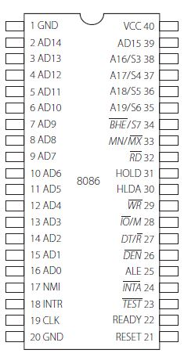
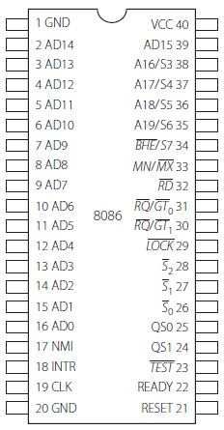
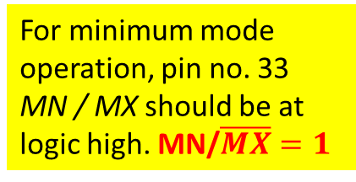
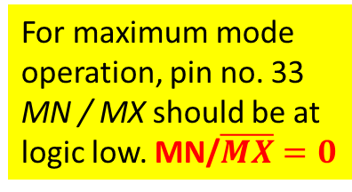
PIN Details of 8086 contd…
Modes of operation of 8086
Minimum mode
Maximum mode
Minimum mode is used when the 8086 is used in single processor systems
Maximum mode is used when the system is a multi processor system, in which the 8086 is one of the processors
For minimum mode operation, pin no. 33 MN / MX should be at logic high. MN/$\overline{MX}=1$
For maximum mode operation, pin no. 33 MN / MX should be at logic low. MN/$\overline{MX}=0$

Slide 38
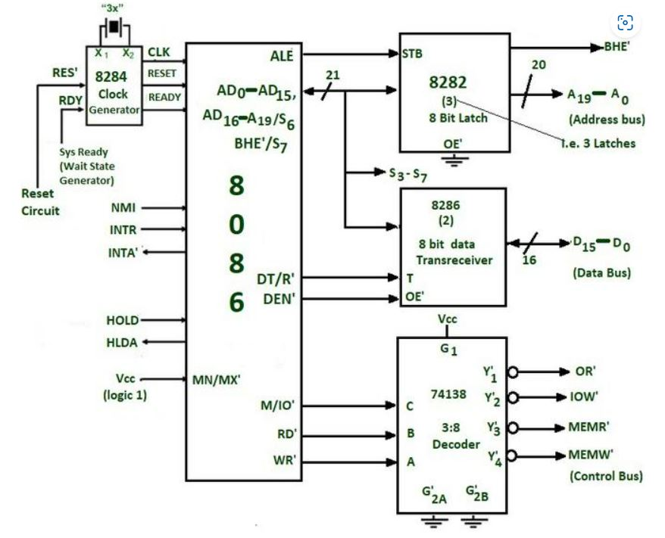
Min Mode
8282 (8 bits) latch
The latches are buffered D FF.
8286 (8 bits) transceivers :
Control signals provided by 8086 for memory operations and i/o interfacing

Slide 39
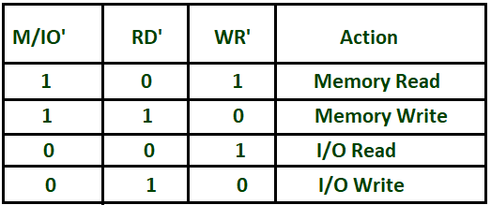
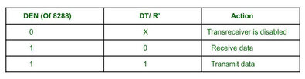
Min Mode
Control signals for all operations are generated by decoding M/IO’, RD’, WR’. They are decoded by 74138 3:8 decoder
The direction of data on the data bus is controlled by the DT/R’ signal.

Slide 40
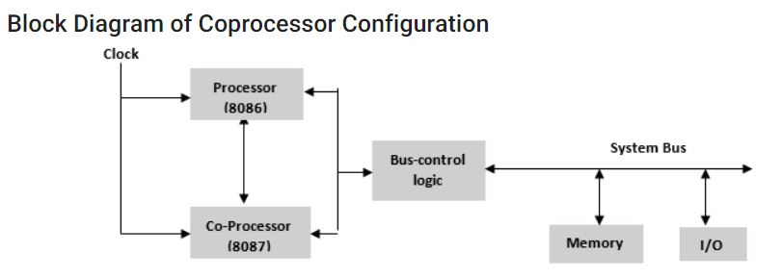
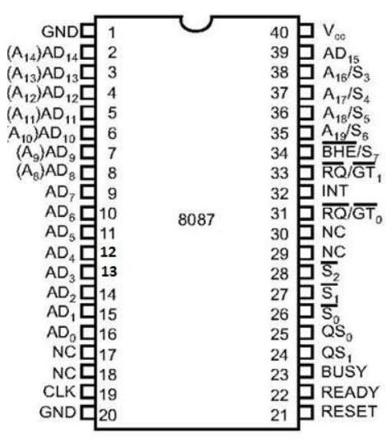
Co-processor 8087
A Coprocessor is a specially designed circuit on microprocessor chip which can perform the same task very quickly, which the microprocessor performs. It reduces the work load of the main processor. The coprocessor shares the same memory, IO system, bus, control logic and clock generator. The coprocessor handles specialized tasks like mathematical calculations, graphical display on screen, etc

Slide 41
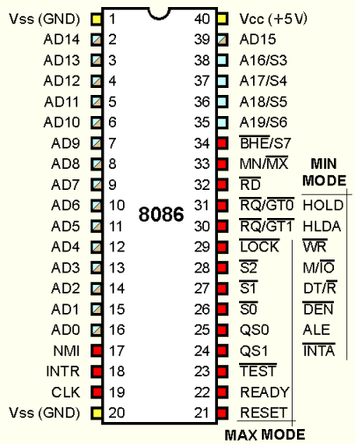
What is the apparent problem ?

Slide 42
Some of the control signals must be generated externally, due to redefinition of certain control pins on the 8086.
The following pins are lost when the 8086 operates in Maximum mode .
ALE
WR
IO/ M
DT/ R
DEN
INTA

Slide 43
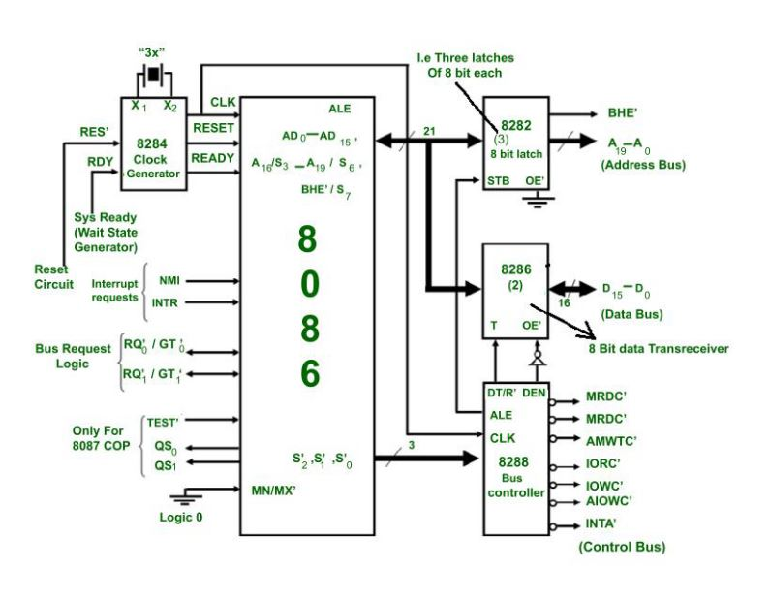
Max Mode

Slide 44
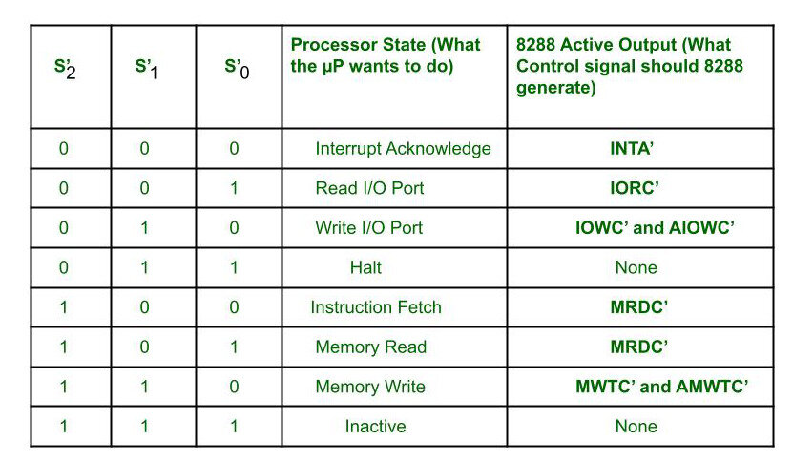
Control signals for all operations are generated by decoding S’₂, S’₁ and S’₀ using 8288 bus controller.

Slide 45
Advantages of max mode of 8086:
It helps to interface more devices like 8087. In this 8086 is called as the host and 8087 as Co-processor.
It supports multiprocessing, Therefore it helps to increase the efficiency.
The purpose of the 8087 was to increase calculations operations, such as add, sub, multiply, divide, and square root.
Disadvantages of max mode over min mode :
It has more complex circuit than min mode.
Applications of 8086:
Microcomputer are built using 8086. For example : IBM PC, used the Intel 8088, a version of the 8086 with 8-bit data bus.
It is used in calculators.
It is used for control purposes like in traffic signals(uses micro controllers which are nothing but contains one or more CPUs along with memory and programmable i/o peripherals).

Slide 46
Timing Diagrams contd…
Read Machine Cycle
The steps involved in a typical read machine cycle are:
Place on the address bus, the address of the location whose content is to be read. This action is performed by the processor.
Assert the read control signal which is part of the control bus.
Wait until the content of the addressed location appears on the data bus.
Transfer the data on the data bus to the processor.
De-activate the read control signal. The read operation is over and the address on the address bus is not relevant anymore.
Step-1: Address of instruction code is placed on Address bus
Instruction codes are stored inside Memory-chip
Microprocessor
(Instruction code is decoded and executed)
Step-2: RD signal is sent to Memory chip
Step-3: Content of the address location is placed on data bus from memory chip

Slide 47
Timing Diagrams contd…
Write Machine Cycle
The steps in a write machine cycle are :
Place on the address bus, the address of the location to which data is to be written.
On the data bus, place the data to be written.
Assert the write control signal which is part of the control bus.
Wait until the data is stored in the addressed location.
De-activate the memory write signal. This ends the memory write operation.
For the 8086, the control signals for a write machine cycle is WR. Also the DT / R signal will be high (for ‘data transmit’) for writing.
The write bus cycle also uses 4 T states normally.
Step-1: Address (where data is to be written) is placed on Address bus
Memory-chip
Or output device
Microprocessor
Step-2: Content of data to be written is placed on data bus
Step-3: WR signal is sent to Memory chip/Output device

Slide 48
Bus Timing
The 8086/8088 microprocessors use the memory and I/O in periods called bus cycles.
Each bus cycle consists of 4 clock cycles.
Thus for 8086 running at 5MHz it would take 800ns for a complete bus cycle.
Each read or write operation take 1 bus cycles.

Slide 49
System Timing Diagrams
T-State:
One clock period is referred to as a T-State
T-State
An operation takes an integer number of T-States
CPU Bus Cycle:
A bus cycle consists of 4 or more T-States
T1
T2
T3
T4

Slide 50
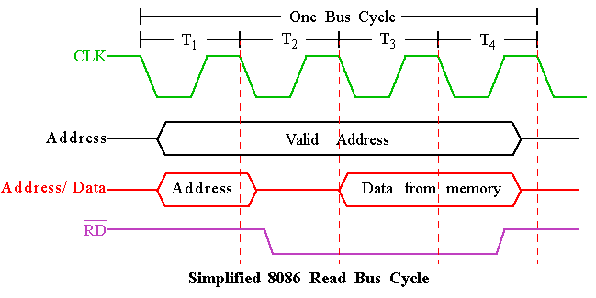
Memory Read Timing Diagrams
Dump address on address bus.
Issue a read ( RD ) and set M/ IO to 1.
Wait for memory access cycle.
A16-A19
AD0-AD15

Slide 51
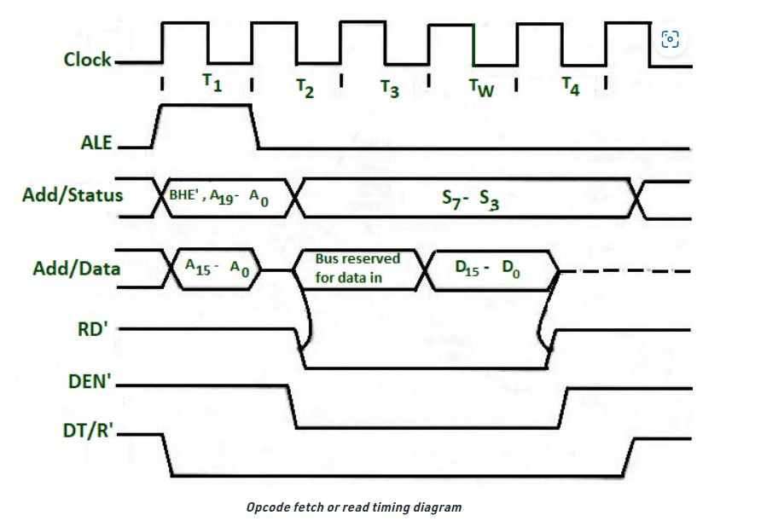
Timing Diagram for Read operation

Slide 52
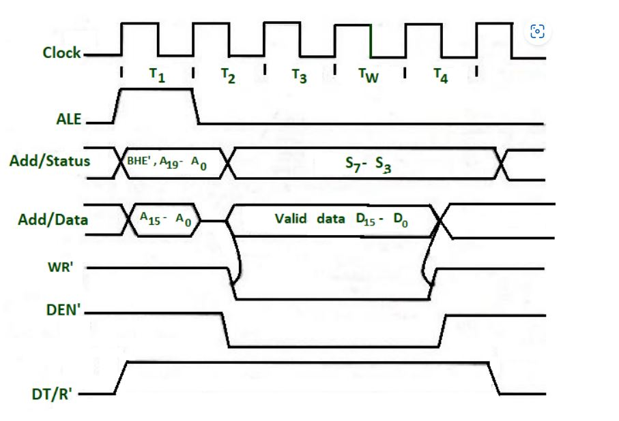
Timing Diagram for Read operation

